Slide 1

Industry Accelerator: Information Assistant Adoption Workshop
Industry & Partner Sales
WW Public Sector
WWPS Industry Solutions Team
isat-support@microsoft.com
Notes:
Welcome to Session 1 of the Information Assistant adoption workshop brought to you by the Microsoft Worldwide Public Sector Industry Solutions team.

Slide 2
Agenda
01
Accelerator Overview
What is the Information Assistant Accelerator?
02
Architecture Review
Drill into the architecture and data flows
03
Contributing to the Accelerator community
Quick tour of GitHub repo, how to access and provide feedback
04
Accelerator Deployment Requirements
Azure, Deployment and Skillset Requirements
05
Deploying the Accelerator
Tools, Skills, and process of Deployment
Notes:
In this Session, we will cover the following topic modules:
First, an overview of the Information Assistant Accelerator.
Next we will cover a review of the accelerator architecture
We will then discuss how to contribute and participate in the accelerator community hosted on GitHub
After those topics we will dive in to preparing your Azure and Deployment environments
And finally in this session we will discuss how to deploy the accelerator in your own Azure subscription.

Slide 3
Accelerator Overview
Notes:
In this module, we will discuss the challenges which have given rise to the Information Assistant, what it is, and what comes with it.

Slide 4
Key Challenges with Large Language Models (LLMs)
Dated Models/Information
Inability to use Private Datasets
Fabrications (aka Hallucinations)
Lack of Citations/References
Lack of transparency on “Thought Process”
Notes:
Leveraging Large Language Models for industry use cases present several challenges due to how they are built and how they work, not to mention the Generative AI field being a fairly new technology.
First, LLMs, such as GPT, are trained off of large amounts of historic data. As such, the information used is inherently old – maybe several years old.
Next, as they are generally trained on public data, they aren’t aware of the contents of private data, such as the data in your SharePoint, PDFs, Word Docs, or internal web sites.
At their heart, an LLM is really just trying to predict what word to use next in a response. LLMs are very complex, but they are not sentient. As such, they will try to provide an answer to any question posed to them. Work is required to guide the LLM to respond truthfully and not fabricate answers.
Also due to the LLM simply predicting the next words to say, it isn’t able to reference the documents which may have contributed to the response. This is a critical capability that humans need to verify the authenticity of the response given.
Finally, there is very little transparency provided by an LLM on how it came up with the answer, or even what information went in to generating the answer in the first place.
With all of these challenges in mind, we’ve created the Information Assistant accelerator as we look to apply LLMs to industry challenges.

Slide 5
Information Assistant powered by Azure OpenAI
Create an “assistant” that will enable users to “Have a conversation with their private/domain specific data” by leveraging the power of a large language model where the responses are:
Current - Responses can be based on the latest “up to date” information
Relevant – The responses must leverage their own private/domain specific data
Controlled - Provide the ability to adjust the response from precise to creative
Referenced – Respond using references/citations
Personalized - Respond with your role/persona in mind
Explainable - Providing details on the “thought process” that was used
Notes:
The Information Assistant accelerator was created to enable the use of Large Language Models on your own private or domain-specific data.
The Information Assistant leverages the Azure OpenAI services running around the globe. These OpenAI services make the OpenAI models available via API access at scale, with predictable pricing. In addition to LLMs, this accelerator takes advantage of many of the other features of the Azure suite of Cognitive Services, such as Cognitive Search, translation, and other AI-based technologies. This accelerator is delivered 100% in the cloud for rapid deployment and scale.

Slide 6

What’s “in the box”?
All source code for the Accelerator
Deployment Scripts and Instructions
Sizing Estimates and Tools
Architecture Documentation
Private collaborative community
Notes:
This accelerator provides all source code need to deploy in Azure. The source code is covered by an MIT license to facilitate your use and adoption, with 3rd party dependencies imported.
The accelerator includes scripted deployment with BICEP and instructions for use.
We also provide sizing estimates and tools to help you gauge the cost of your deployment.
We provide architecture and feature documentation as well as this adoption workshop content.
And finally, this is paired with this private GitHub community where you can engage all users of this repository, both from inside and outside Microsoft.

Slide 7
Architecture
Notes:
In this module we will discuss the high level architecture of the Information Assistant accelerator, and dive in to the two key data flows – data ingestion and end user data flow.

Slide 8
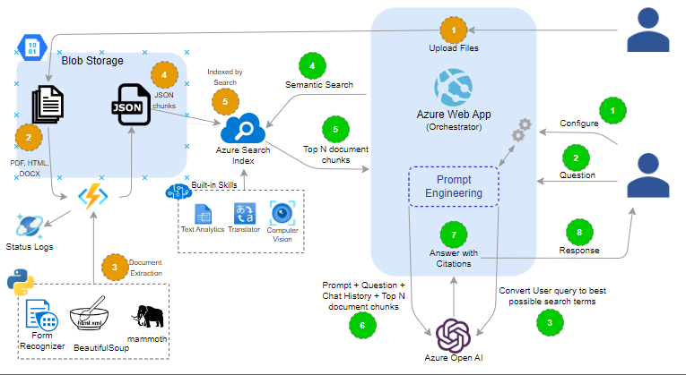
High Level Architecture
Notes:
The accelerator is fully deployed in the Azure cloud, and is composed of two main components:

Slide 9
High Level Architecture
Notes:
The accelerator is fully deployed in the Azure cloud, and is composed of two main components:
The first key component is the main webapp. This is the interface which end users interact to use the accelerator, as well as upload data into the system. The webapp itself also makes calls out to the Azure OpenAI service to leverage the power of the Large Language Model GPT.

Slide 10
High Level Architecture
Notes:
The accelerator is fully deployed in the Azure cloud, and is composed of two main components:
The first key component is the main webapp. This is the interface which end users interact to use the accelerator, as well as upload data into the system. The webapp itself also makes calls out to the Azure OpenAI service to leverage the power of the Large Language Model GPT.
The second key component is the Azure Cognitive Search engine and the associated data storage and processing which prepare the data for search. This system takes input documents and breaks them into logical chunks which the Azure OpenAI service can understand. This system is key for organizing, storing and retrieving the content which the system is operating on.

Slide 11
Data Flow: Uploading Private Data
Notes:
To enable GPT to work over your private and domain-specific data, the data must be uploaded to the system. There are several connectors available to different data sources which may be enabled in the future, but at the initial release this accelerator allows the user to select and upload the Word, PDF and HTML documents of their choice to the system via the Webapp interface.

Slide 12
Data Flow: Uploading Private Data
Notes:
Uploaded files are placed in blob storage and sent through Azure Functions to break the files into smaller chunks. For this process we use a number of AI-based technologies to understand the structure of the files and create meaningful chunks. Much of the work for this accelerator has gone into the chunking strategy to make the data meaningful. In particular we leverage Azure Form Recognizer/Document Intelligence to understand the structure of the document and ensure that chunks of data are parsed with related content. For example, if a page in the document is multi-column, ensuring that the content chunk includes the remainder of a paragraph in the next column, or next page. If the text is related to a diagram or table, keeping them together is key to enable GPT to process them in a meaningful way.

Slide 13
Data Flow: Uploading Private Data
Notes:
Once document chunking is complete, the chunks and their metadata are stored in a Cognitive Search index. Cognitive search employs several tools to make the data more valuable and improve relevance of search results. Depending on the specific release, these technologies will change over time. At the time of this recording, we are mid-integration of Cognitive Search’s Vector Search capability, for example.

Slide 14
Data Flow: Querying Private Data
Notes:
Using the system to query private and domain-specific data stars with the end user engaging with the webapp console. The end user has the ability to configure the session – set personas, choose chunks to receive, and fine tune the GPT response – all impacting the Prompt to GPT.

Slide 15
Data Flow: Querying Private Data
Notes:
The end user’s query is sent first to Azure OpenAI service to be converted to the best possible search query. The LLM looks at the question and determines the context information to generate the query. On initial query, this may only e from the entered question, but on subsequent questions, it will take into consideration the history of the conversation to generate this query.

Slide 16
Data Flow: Querying Private Data
Notes:
Once the query is generated, it is issued to the Cognitive Search system to retrieve the configured number of chunks. The number of chunks was configured in Step 1. The chunks are then returned back to the webapp.

Slide 17
Data Flow: Querying Private Data
Notes:
With the chunks returned from Cognitive Search, the entire prompt, any chat history, and the chunk data are all sent to the OpenAI service. The service is instructed through an engineered prompt to use the data presented to answer the question asked by the end user. The prompt also instructs the system to not fabricate answers if the data presented to it does not include an answer to the question asked. If an answer is provided, the system is also directed to provide citations to the chunks of data that were used to answer the question – this allows the end user to verify the document and data use in the answer provided by the system.

Slide 18
Contributing to the Accelerator community
Notes:
In this module we will discuss how to engage with the accelerator community for common tasks such as raising issues, discussing topics, and contributing code.

Slide 19
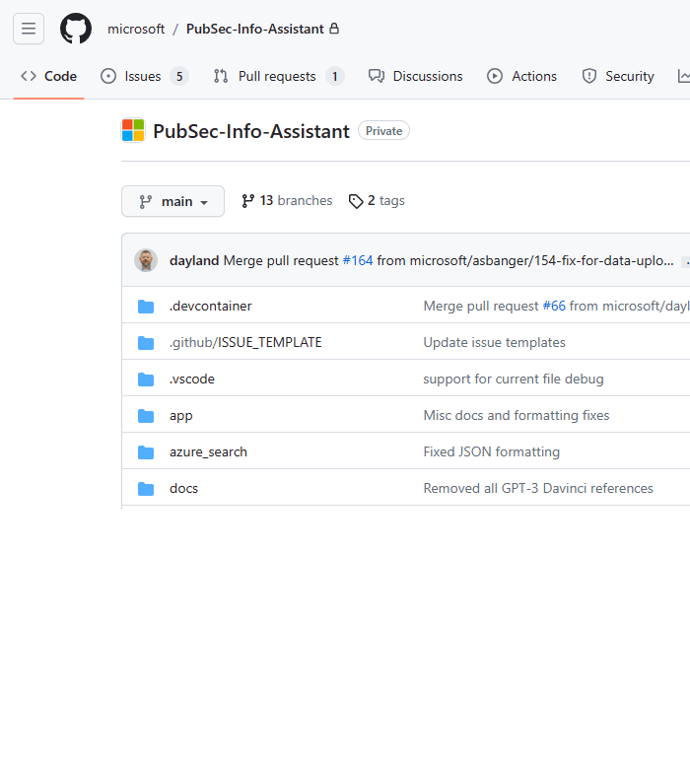
Getting around the GitHub repo
Provides access to
Source code
Markdown (.md) files
README
Deployment Guides
Feature Documentation
Issues
Discussions
Notes:
The Information Assistant accelerator community is hosted in a private GitHub repository
This is where you’ll be able to access and contribute to the source code as well as find full documentation on the accelerator
The best place to start is the README markdown file at the top level of the code repository.
Also here, note the top level tabs for Issues and Discussions – these sections are your direct method for interacting with the community. Use the Issues tab to report non-security-related bugs and feature requests, and use the Discussions tab to discuss absolutely anything related to the accelerator.
Once you have gone through that there are a few other locations in the repository where you can find more detailed documentation, which we will discuss next

Slide 20
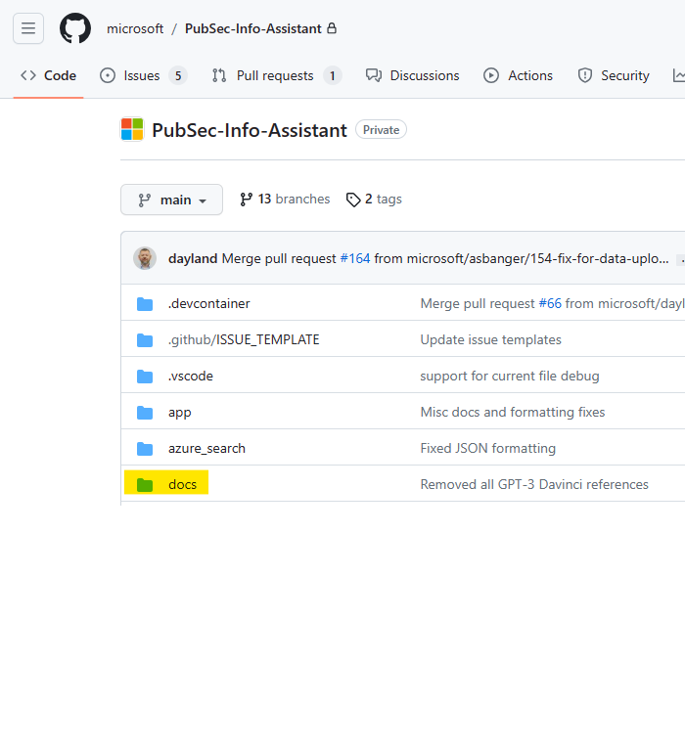
Navigating the documentation
Use the “docs” folder to learn about the accelerator
“features” folder contains documentation on specific capabilities
Note that there is documentation throughout the codebase
Notes:
Most of the accelerator’s detailed documentation is located in the docs directory.
The documentation covers a wide array of topics from architecture and troubleshooting to transparency around the application of AI.
Be sure and check out the features folder, specifically as it contains documentation on specific capabilities as well as coverage of unique usage of specific components.
Documentation also exists alongside the source code to detail the design and usage of specific components. This is where you’ll find the most detailed information

Slide 21
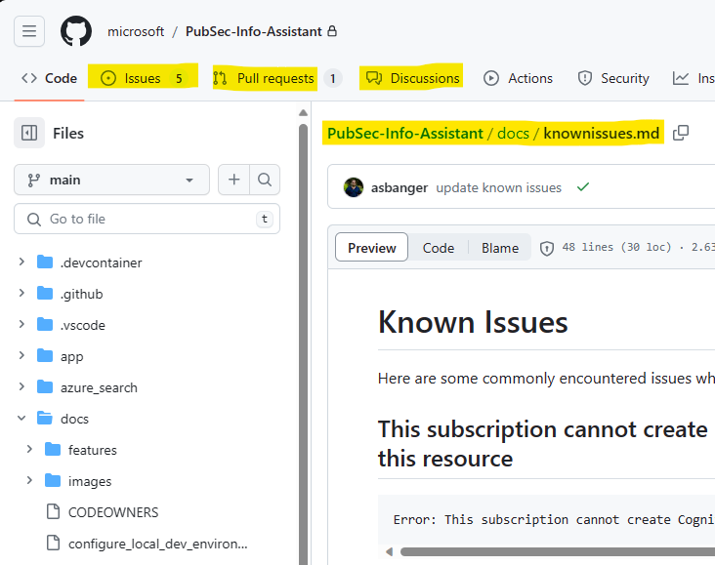
Contributing to the accelerator
Participate in Discussion threads as part of the community
Submit issues and feature requests
Read up on Known Issues
Create Pull requests to contribute code back
Notes:
Besides documentation, we encourage you to leverage the GitHub community features in order to learn more and become involved in the Information Assistant accelerator.
You can join in on the discussion threads within the community, report bugs and feature requests, and learn about known issues. Should you resolve a bug or create a new feature, please submit a Pull Request to have the work considered for integration into the Main release.

Slide 22
Accelerator Deployment Requirements
Notes:
This module will discuss the requirements that must be met to deploy this accelerator.

Slide 23
Azure Environment Requirements
01
Active Azure subscription (non-trial)
02
Administrative rights on the Azure subscription
03
Approval to access Azure OpenAI models
Request form: https://aka.ms/oai/access
04
(Optional) Approval for GPT-4 OpenAI model access
Request form: https://aka.ms/oai/get-gpt4
05
(Optional) Modified content filtering (disable)
Use this request form.
Notes:
First you must have an active Azure subscription. For this accelerator it must be a paid subscription (not a free trial).
This is primarily due to the use of Azure Cognitive Services. While you can create a free tier of many of the Cognitive Services, you can only create one free Cognitive Service in an account. As the features of this accelerator use several Cognitive Services, a paid subscription is required
Beyond the subscription the person performing the deployment will need administrative rights on the Azure Subscription:
This is Required as some steps such as enabling an Azure Service Registration require higher permissions that Contributor.
You will need to be approved to access Azure OpenAI services and models. Please use the provided links to set up each Azure subscription where this accelerator will be installed.
Note that you can have multiple subscriptions with approved usage. This may be beneficial to you depending on your ability to access GPT-4 and advanced models.
Also note that you must accept the terms and conditions of the Azure OpenAI service _before_ you can deploy this accelerator:
In the Azure portal, navigate to the “Create a resource” page and search for “Cognitive Services”
Select “Cognitive Services” from the list of results and click “Create” 1.
On the “Create” page, provide the required information such as Subscription, Resource group, Region, Name, and Pricing tier 1.
Review and accept the terms "Responsible AI Notice"

Slide 24
Deployment Requirements & Skillsets
01
A computer with a modern web browser (e.g.: Edge, Chrome)
02
(Optional) Visual Studio Code
03
Familiarity with Azure and service administration
04
Familiarity with GitHub
05
Basic command line skills
Notes:
With the Azure requirements met, we are one step closer to deployment, and we’re now going to focus on what will be required by the person performing the deployment.
They will need a computer with a modern web browser.
The deployment of Information Assistant leverages GitHub Codespaces. This feature launches a container in the cloud to create a standardized and pre-configured development environment for the end user. This environment provides a running instance of Visual Studio Code (VS Code) from which you can deploy directly to your Azure tenant.
An Optional local installation of VS Code will be needed if your organization requires managed devices to access your Azure tenant. If that is the case, install VS Code on your computer and when executing the installation, simply choose to launch the Codespaces environment with your VS Code installation on your managed device.
Basic familiarity with Azure and it’s service administration will be helpful. Specifically you will need to authenticate to Azure for the installation. This will be initiated from the command prompt in the VS Code instance you choose to leverage.
Familiarity with GitHub will be helpful for creation of the Codespace you wish to install from. Note that you can have several Codespaces, across several forks of the repository. This enables you to rapidly install different versions and test different codebases or bug fixes.
You will need basic command line skills to issue the few installation instructions required

Slide 25
Deploying the Accelerator
Notes:
This module will cover the steps needed to deploy the accelerator.

Slide 26
Deployment overview & helpful hints
Overview:
Development and Deployment for the accelerator are enabled via GitHub Codespaces
Pre-configured cloud-based container, dedicated to a specific branch of code
Visual Studio Code (VS Code) environment provides all the tools you need
Deployment (make) uses templates and command line tools to deploy and configure the codebase in Azure
Read up on Deploying with Codespaces documentation
Helpful hints:
The deployment is designed to be performed in order
Verify all prerequisites before deploying – preparation is key
See Deployment Documentation for latest instructions
Use the Discussion for help with any issues
If your organization enforces device management, open your Codespace from VS Code on your managed device
Notes:
If you haven’t reviewed the Accelerator Deployment Requirements module please be sure to do so before attempting to deploy. This accelerator requires pre-work to enable Azure OpenAI services.
Both development and deployment are done inside of a pre-configured development container using Visual Studio Code provided via GitHub Codespaces feature.
Deploying Azure resources is done using the popular command line build tool called make. The make commands in the accelerator automate operations and deployment by taking the user supplied configs and templates as well as other command line tools like Azure CLI and deploys the accelerator codebase in Azure for you.
Please take time to read and understand the “Deploying with Codespaces” documentation provided.
While the accelerator has been designed for ease of use, please keep in mind the following guidelines
Follow the documentation in the order that is written. This means ensuring that all the prerequisites have been completed before deploying.
For the latest guidance be sure to checkout the Deployment Documentation in the README file, which is located at the root of the repo
If you do run into any issues take a look at the Discussion section in the github repo
If you organization enforces device management, open your Codespace from VS Code on your managed device.
Now let’s take a high level look at the steps involved in deploying the accelerator

Slide 27
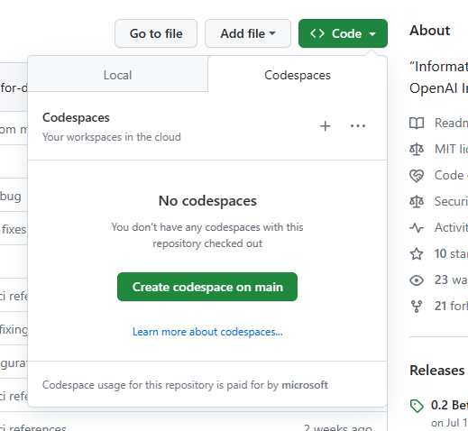
Deployment overview & helpful hints
Deployment is comprised of the following steps:
Verify all prerequisite components (accounts and subscriptions)
Create a Codespace environment from the branch you wish to deploy
Deploy the components
Configure environment variables in Codespace environment
Deploy Azure Resources via Codespace (VS Code) command line
Always check the README and Known Issues for updates!
Notes:
To deploy the Information Assistant accelerator you’ll need to do the following
First, you’ll need to setup all the required accounts and subscriptions which include Azure and access to the OpenAI models. Verify in Azure that you have access to your desired model(s).
Next you will create a Codespace environment from within GitHub. This is as simple as choosing the branch you wish to deploy, then selecting the “Code” drop down on the web page and choosing to “Create codespace”. Codespaces run inside the Microsoft GitHub deployment and are paid for by Microsoft. Once the container starts up, you will see a Visual Studio Code environment with your source code checked out. From this environment, you can deploy your chosen branch’s codebase, or make changes to the codebase and check them in.
Please note that the Codespace is running in the GitHub cloud environment (on Azure). If your organization requires your device to be managed to deploy to Azure, you can choose to open the codespace in VS Code on your managed device. This can be any managed device that can run VS Code.
Finally, you will deploy the components of the accelerator. This includes:
Configuring the environment variables for your deployment – values such as Subscription ID where you want to deploy, and language settings. Please note that there are several sample variable files which showcase how to configure for multiple languages. As the accelerator uses language detection on incoming documents, it is important to ensure that you have your installation configured for the language you wish to normally use. This will ensure that there are not multiple translations along the way (for example, translating from Greek to English and back to Greek).
Once your environment is ready, you will perform the Azure login to your tenant, and issue the single ‘make deploy’ command.
Once again, be sure to check the documentation in the github repo for the lastest deployment instructions. If you run into issues, check the Known Issues page for potential resolutions, as well as Discussion forum and Issues list. If you can’t resolve your issue, please create an Issue or Discussion as appropriate.

Slide 28
Notes:
Thank you for taking the time to watch these modules. If you have any questions or encounter challenges, we encourage you to use the Discussion forum in GitHub, or email us at isat-support@microsoft.com depending on the nature of your issue.

